Slide 1
Cloudburst prediction system
PIP4004 University Project
Review-0
Batch Number: CSE-G135
Under the Supervision of,
Ms. Rakheeba Taseen
Professor / Associate Professor / Assistant Professor
School of Computer Science and Engineering
Presidency University
Roll Number | Student Name
20211CSE0413 | Sushma M Maddin
20211CSE0421 | Sinchana A U
20211CSE0437 | K H Srujan Gowda
Name of the Program: B.Tech
Name of the HoD: Dr. Asif Mohammed H B
Name of the Program Project Coordinator:
Name of the School Project Coordinators: Dr. Sampath A K

Slide 2
Content
Problem Statement
Github Link
Analysis of Problem Statement
Timeline of the Project
References

Slide 3
Problem Statement Number: PSCS_91
Organization: Ministry of power
Category (Hardware / Software / Both) : Software
Difficulty Level: Complex
Title: Cloudburst prediction system

Slide 4
Problem Statement Number: PSCS_91
Problem Statement Description
Cloudbursts are sudden, intense rainfall events that can cause severe flooding and destruction. Traditional forecasting methods often fail to provide precise warnings due to the unpredictable nature of cloudbursts. This project aims to develop a Machine Learning-based Cloudburst Prediction System by analyzing meteorological parameters such as temperature, humidity, pressure, wind speed, and rainfall intensity. Using historical weather data and real-time inputs, the system will train a predictive model to assess cloudburst probability. A web application will allow users to enter weather data manually for automated predictions. Additionally, an alert mechanism can be integrated to notify users via SMS, email, or push notifications when a high probability of a cloudburst is detected. This system enhances early warning capabilities, aiding disaster preparedness and response.

Slide 5
Github Link
Github Link:
https://github.com/Sushma-M-Maddin/PSCS_91_CSE121-cloudburst-prediction-system

Slide 6
Analysis of Problem Statement
1. Frontend (Web App)
React.js → For building the UI
CSS → For styling
Axios → To send data to the backend
2. Backend
Flask (Python) → To handle requests and run the ML model
Node.js + Express (Alternative) → To handle the JavaScript

Slide 7
Analysis of Problem Statement (contd...)
3. Machine Learning (Model Training & Prediction)
Python → Core language for model development
Libraries:
Pandas, NumPy → Data processing
Scikit-learn → ML algorithms
Matplotlib, Seaborn → Data visualization

Slide 8
Analysis of Problem Statement (contd...)
Software & Tools
OS → Windows
VS Code / Jupyter Notebook → For development
Postman → For testing
Git & GitHub → Version control
Kaggle → For the dataset

Slide 9
Analysis of Problem Statement (contd...)
Problem Statement: Cloudbursts are sudden, intense rainfall events that can cause severe flooding and destruction. Predicting them accurately can help prevent disasters and save lives. The goal of this project is to develop a Machine Learning-based Cloudburst Prediction System using historical meteorological data.
Challenges:
Lack of real-time datasets → Need to fetch data
High variability in weather conditions → Complex model training
Notifications → Must integrate alert systems
Proposed Solution:
Phase 1: Data Collection & Preprocessing
Phase 2: Machine Learning Model Development
Phase 3: Web Application for Predictions

Slide 10
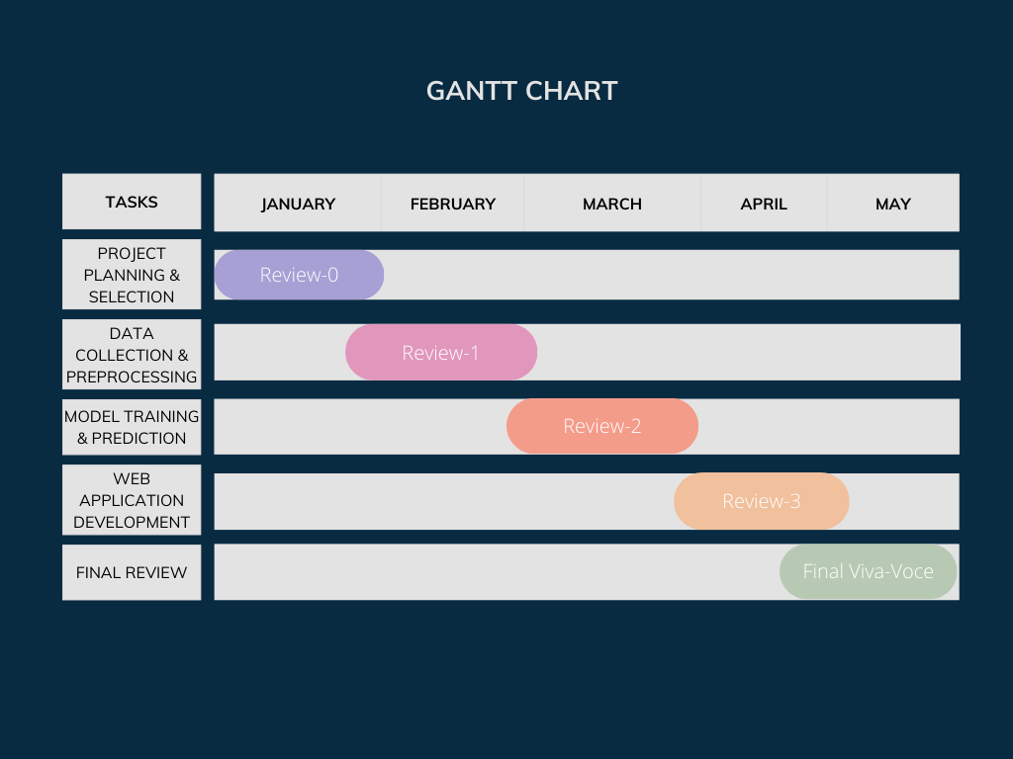
Timeline of the Project (Gantt Chart)

Slide 11
References (IEEE Paper format)
"Cloudburst Prediction in India Using Machine Learning" Summary: This study explores cloudburst forecasting in India by leveraging machine learning techniques, addressing challenges posed by limited data availability.
Link: IEEE Xplore
"Cloudburst Prediction System Using Machine Learning" Authors: Supriya Telsang, Prutha Sawale, Sumit Pujari, Vaibhav Pujari, Aryan Pungale, Rahi Dubewar, Rahul Shendre Summary: This research discusses the development of a cloudburst prediction system employing machine learning techniques to forecast cloudburst events based on various meteorological features across India. Link: IJRASET
"Enhancing Cloudburst Prediction System Using Bi-LSTM in Realtime" Authors: [Author(s) not specified] Summary: This paper explores the use of Bidirectional Long Short-Term Memory (Bi-LSTM) models for real-time rainfall prediction, aiming to improve the accuracy of cloudburst forecasts. Link: International Journal of Scientific Research in Computer Science Applications and Management Studies
"Cloudburst Prediction System Using Machine Learning" Authors: [Author(s) not specified] Summary: This study focuses on implementing a cloudburst prediction system using machine learning, highlighting the challenges and methodologies involved in forecasting such events. Link: ResearchGate

Slide 12


